Slide 1

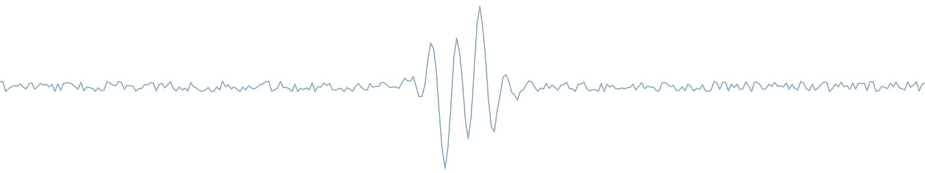
01 — PHASE A
PROJECT CODE 26-2-R-3
Compressing the Earthquake Transformer via Knowledge Distillation
Enhancing efficiency in real-time seismic analysis.
TEAM
ADVISORS
Or Shterenshus - 207186156
Dr. Elena Kramer
Shiraz Balmas Shterenshus - 207721853
Dr. Dan Lemberg
Braude College of Engineering
26-2-R-3 · 01 / 16

Slide 2
02 — OVERVIEW
What we will cover
01
Background
Earthquake detection and EQTransformer
02
Problem
Existing model
03
Proposed Solution
Knowledge Distillation
04
Architecture
Compact model and training objective
05
Summary
Outcomes and what comes next
26-2-R-3 · 02 / 16

Slide 3
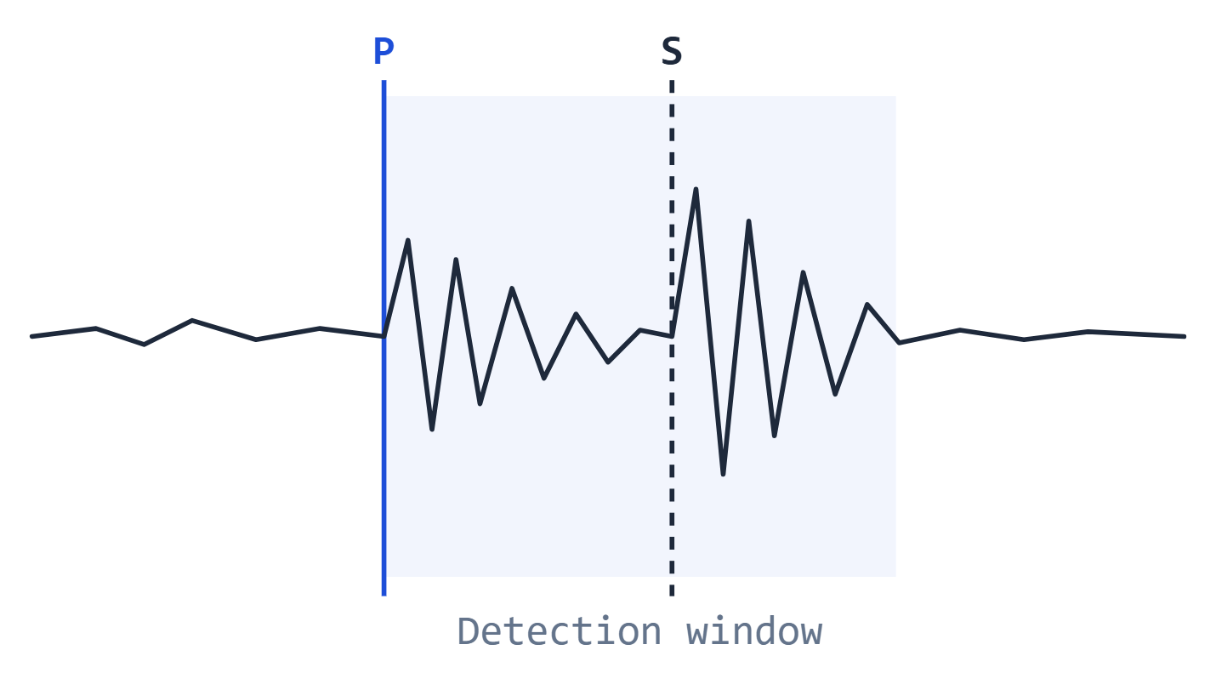
03 — BACKGROUND
Deep learning drives modern earthquake detection
—
EQTransformer is a deep learning model for seismic signal analysis.
—
Detect earthquake events and identify the arrival times of the P-wave and S-wave.
—
These wave arrivals are important because they help locate and analyze earthquakes.
—
The model also uses attention, which helps it understand the signal over time.
26-2-R-3 · 03 / 16

Slide 4
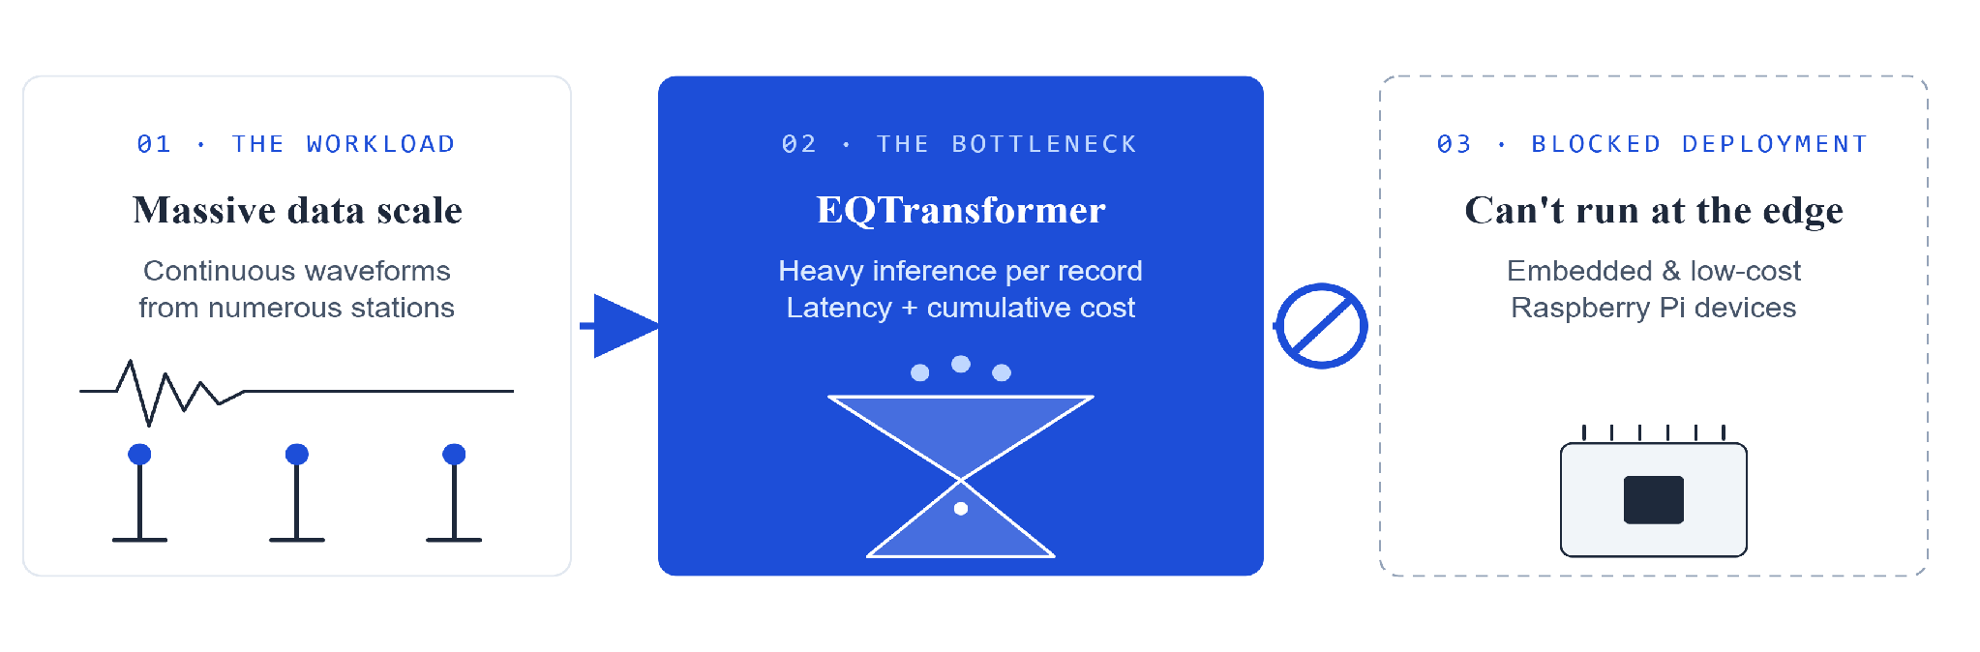
04 — THE PROBLEM
Heavy computation blocks edge deployment
26-2-R-3 · 04 / 16

Slide 5
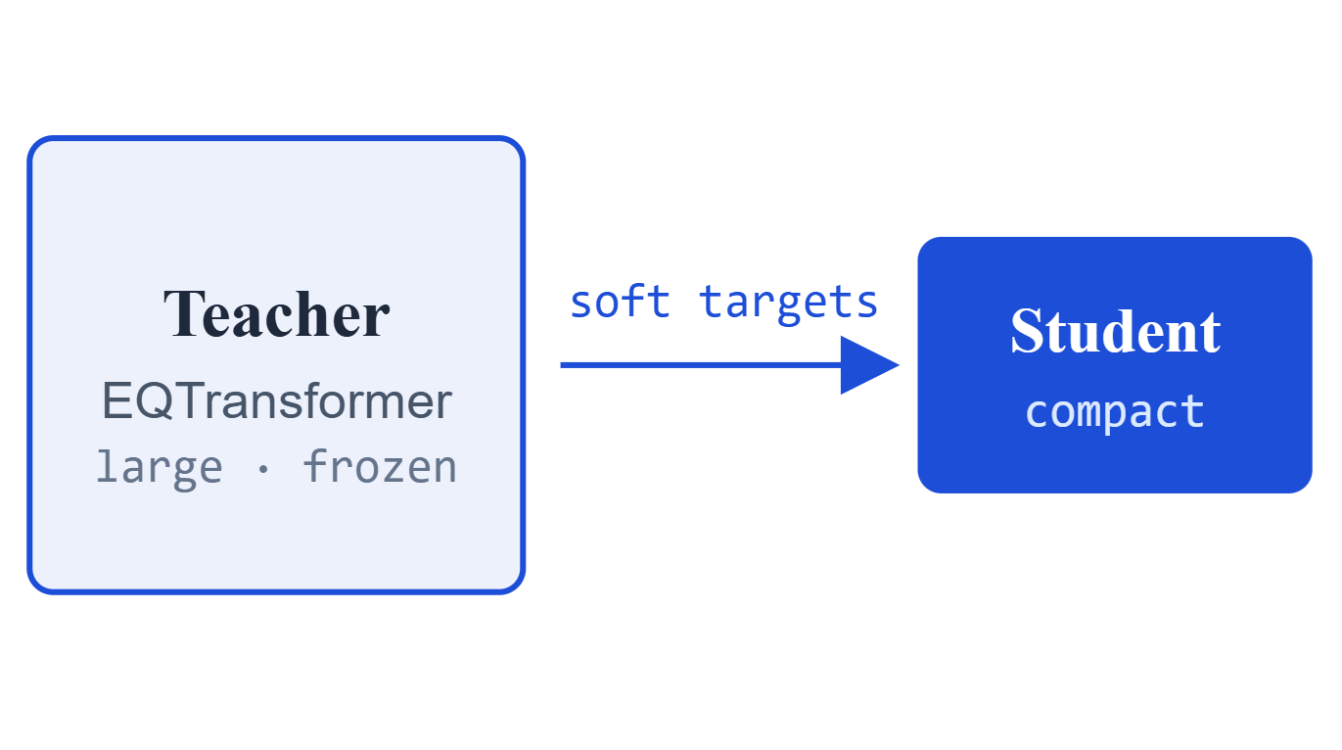
05 — PROPOSED SOLUTION KNOWLEDGE DISTILLATION
Distill the knowledge into a smaller model
We use the original EQTransformer as the teacher, and train a smaller student model to learn from it.
This idea is inspired by DistilBERT, where a large language model is compressed into a smaller one using the same teacher student idea.
The student learns from both the real labels and the teacher’s predictions.
—
—
—
26-2-R-3 · 05 / 16

Slide 6
06 — RESEARCH OBJECTIVES
What success looks like
≥50%
≥95%
Edge
SMALLER
ACCURATE
DEPLOYABLE
Reduce model parameters by at least half.
Retain detection and P/S picking performance.
Run on resource-constrained field devices.
26-2-R-3 · 06 / 16

Slide 7
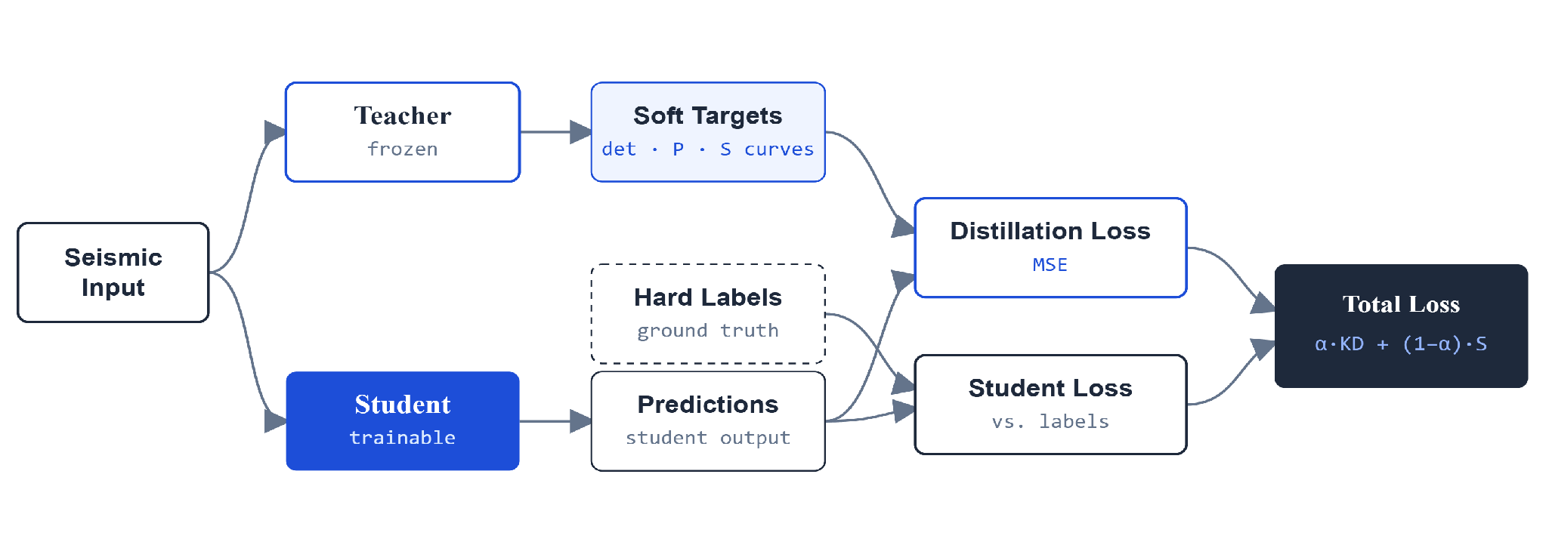
07 — TRAINING PIPELINE
From seismic input to a combined loss
26-2-R-3 · 07 / 16

Slide 8
08 — ALGORITHM & LOSS FUNCTION
Loss Function: Teacher Predictions + Real Labels
L
=
α
·
L_{KD}
+
(1 − α)
·
L_{Student}
—
L_{KD} : Student learns from the teacher’s predictions.
—
L_{Student} : Student’s predictions is compared with the real labels.
—
α : balances teacher predictions and real labels.
—
The student learns full probability curves for detection, P-pick, and S-pick.
26-2-R-3 · 08 / 16

Slide 9
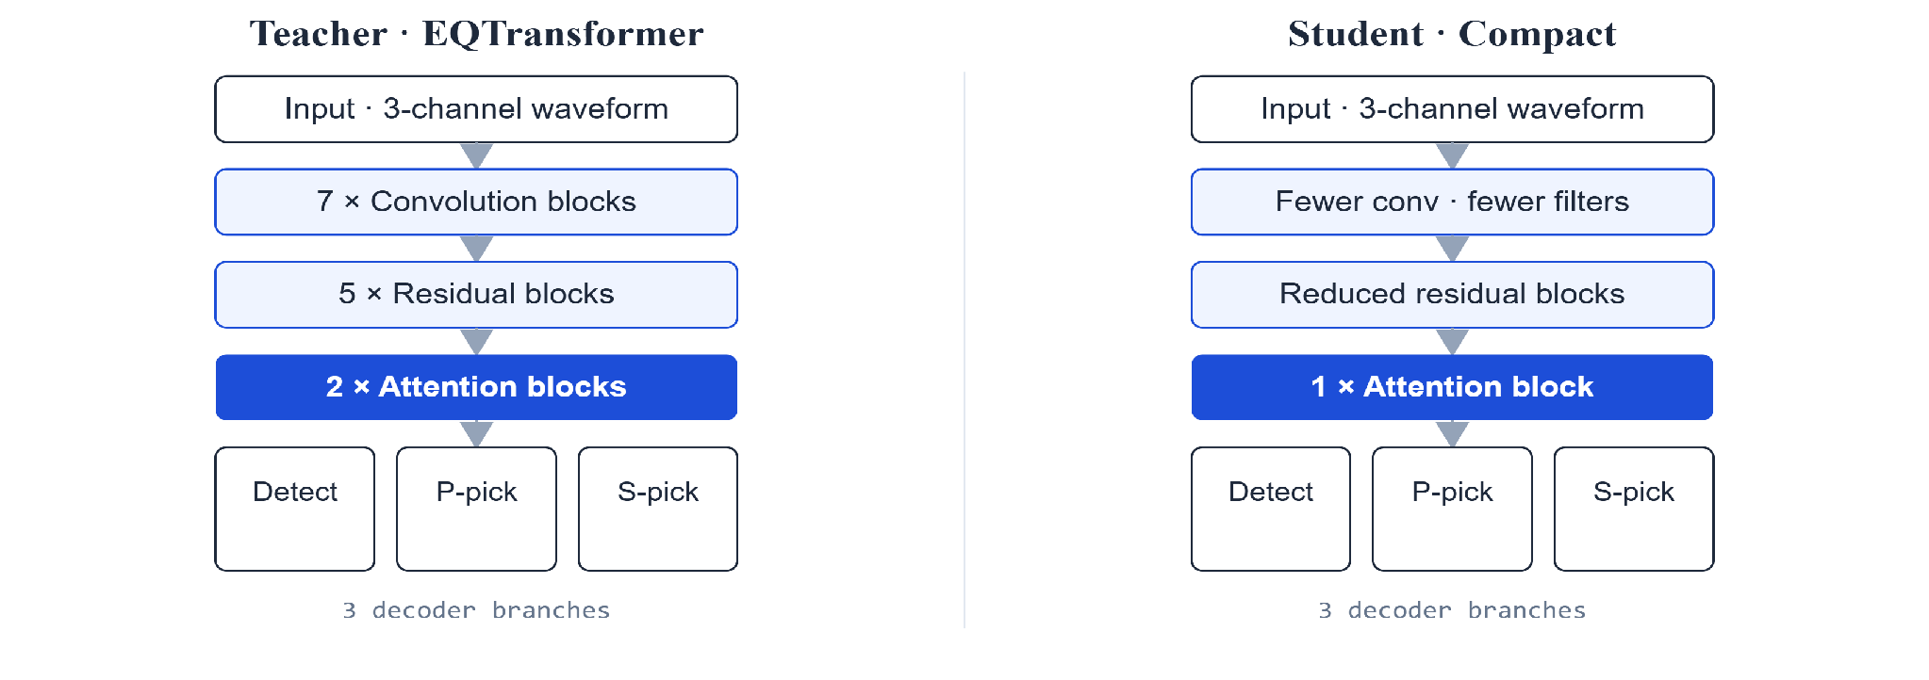
09 — ARCHITECTURES · TEACHER VS STUDENT
Smaller Architecture, Same Seismic Tasks
26-2-R-3 · 09 / 16

Slide 10
10 — DATASETS & METHODOLOGY
Train on one domain, test on another
STEAD
PRIMARY
Stanford seismic dataset used as our main dataset, following the original EQTransformer setup.
K-NET
CROSS-DOMAIN
Japanese dataset for cross-domain testing on unseen data.
Checking if the student can generalize to unseen data from a different domain.
26-2-R-3 · 10 / 16

Slide 11
11 — PRELIMINARY VALIDATION · BASELINE
Our baseline, measured on 100 STEAD samples
373,495
~1.4 MB
99 / 100
PARAMETERS
MODEL SIZE
EVENTS DETECTED
These numbers will be our reference point when evaluating the compressed models later.
26-2-R-3 · 11 / 16

Slide 12
12 — EXPECTED CHALLENGES
What we expect to be hard
01
Keeping P/S picking accurate while shrinking the model .
02
Choosing which layers to remove using an ablation study.
03
Generalization to unseen data from a different domain.
26-2-R-3 · 12 / 16

Slide 13
13 — EVALUATION METRICS
Measured by accuracy and computational efficiency
Prediction Accuracy
Computational Efficiency
Precision
Recall
Model Size
Inference Time
True-positive rate of detections
Events successfully detected
Parameters & MB on disk
Latency per record
RAM Usage
F1-Score
MAE
Peak memory at runtime on edge hardware
Balance of precision & recall
P/S arrival-time error
26-2-R-3 · 13 / 16

Slide 14
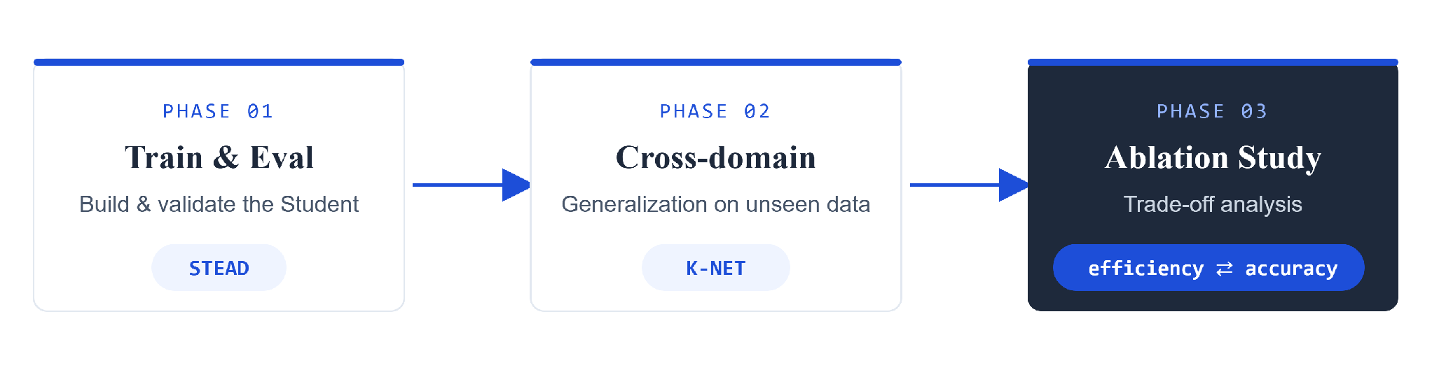
14 — TESTING & VALIDATION PLAN
Three phases from training to trade-off
—
Compare basic performance with the EQTransformer.
—
Test on unseen data from a different source.
—
Compare different student versions and choose the best trade-off.
26-2-R-3 · 14 / 16

Slide 15
15 — SUMMARY
Key takeaways
01
Compress EQTransformer using Knowledge Distillation
02
Targets: At least 50% size reduction and 95% of the original accuracy retained.
03
Train across STEAD and validate on unseen K-NET data.
The final goal is a smaller, efficient, and accurate model for real-time seismic monitoring.
26-2-R-3 · 15 / 16

Slide 16
16 — THANK YOU
Thank you.
Questions & discussion welcome
TEAM
ADVISORS
PROJECT
Or Shterenshus
Dr. Elena Kramer
26-2-R-3
Shiraz Balmas Shterenshus
Dr. Dan Lemberg
Phase A
26-2-R-3 · 16 / 16

